Slide 1

Structured Query Language Buddy
DEPARTMENT OF COMPUTER SCIENCE AND ENGINEERING
Name of Students:
Syed Mustafa
RRN : 220171601123
Vipranan
RRN : 220171601130
Supervisor :
Dr.S.Revathi
Professor CSE
Domain of Project : Generative AI, NLP,DBMS
01

Slide 2
EXISTING SYSTEM
DEPARTMENT OF COMPUTER SCIENCE AND ENGINEERING
Traditional database interaction relies on writing SQL queries, which requires users to have technical knowledge of database schemas, table relationships, and query syntax, making it difficult for non-technical users to access data independently.
Business users and decision-makers depend on data analysts or developers to retrieve information, which increases response time, creates communication gaps, and slows down data-driven decision-making.
Existing Natural Language to SQL systems are often benchmark-focused, costly, domain-specific, and lack real-world usability, scalability, and user-friendly interfaces
02

Slide 3
PROPSED SYSTEM
DEPARTMENT OF COMPUTER SCIENCE AND ENGINEERING
SQL Buddy is a Generative AI–based Natural Language to SQL system that enables users to retrieve information from relational databases by asking queries in plain English.
The system interprets user intent, maps it to the database schema, generates accurate SQL queries, and executes them to present meaningful results.
SQL Buddy reduces dependency on technical teams, improves productivity, and provides an intuitive interface for faster and more efficient data access.
03

Slide 4
OBJECTIVES OF THE PROPOSED SYSTEM
DEPARTMENT OF COMPUTER SCIENCE AND ENGINEERING
To design a system that allows non-technical users to query relational databases using natural language without requiring SQL knowledge.
To ensure the generated SQL queries are syntactically correct, semantically meaningful, and aligned with the underlying database schema.
To improve the speed, efficiency, and accessibility of data-driven decision-making processes.
To develop a scalable and user-friendly solution that can be extended with additional features and adapted to different database environments.
04

Slide 5
DEPARTMENT OF COMPUTER SCIENCE AND ENGINEERING
METHODOLOGY USED
The system first processes the user’s natural language input to identify intent, keywords, conditions, and required operations such as filtering or aggregation.
Relevant tables and columns are selected by mapping the extracted intent to the database schema using schema-aware context.
A Generative AI model generates the SQL query, which is validated, executed on the database, and the results are displayed to the user.
The executed query results are formatted and presented to the user in a clear, structured, and easily understandable manner.
05

Slide 6
DEPARTMENT OF COMPUTER SCIENCE AND ENGINEERING
MODULE DESCRIPTION
The User Input and Query Interpretation modules capture user queries and analyze them to understand intent and required data operations.
The Schema Mapping and SQL Generation modules identify relevant schema elements and generate appropriate SQL queries using Generative AI.
The Query Execution and Result Display modules execute validated SQL queries and present the results in a clear and user-friendly format.
The Result Display and Feedback modules present the query results in a clear, structured, and user-friendly format, allowing users to easily interpret the retrieved information.
06

Slide 7
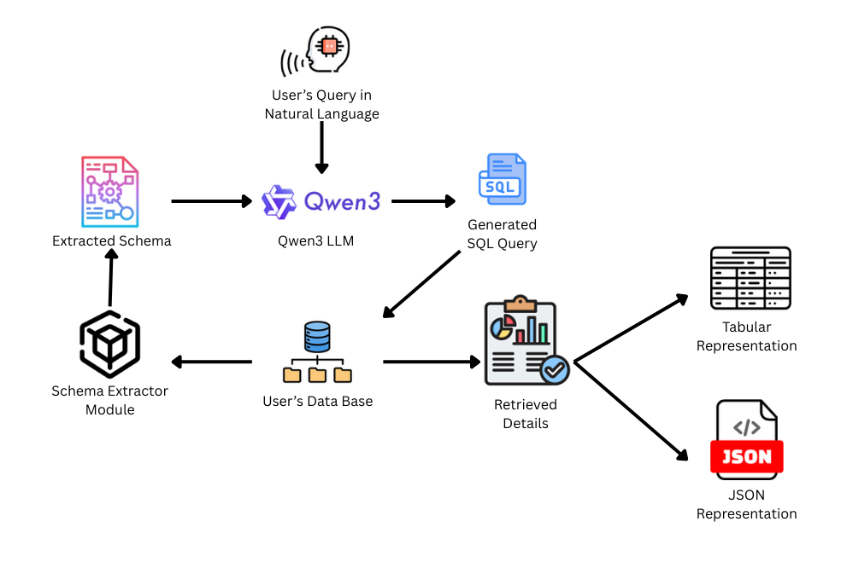
BLOCK DIAGRAM
DEPARTMENT OF COMPUTER SCIENCE AND ENGINEERING
07

Slide 8
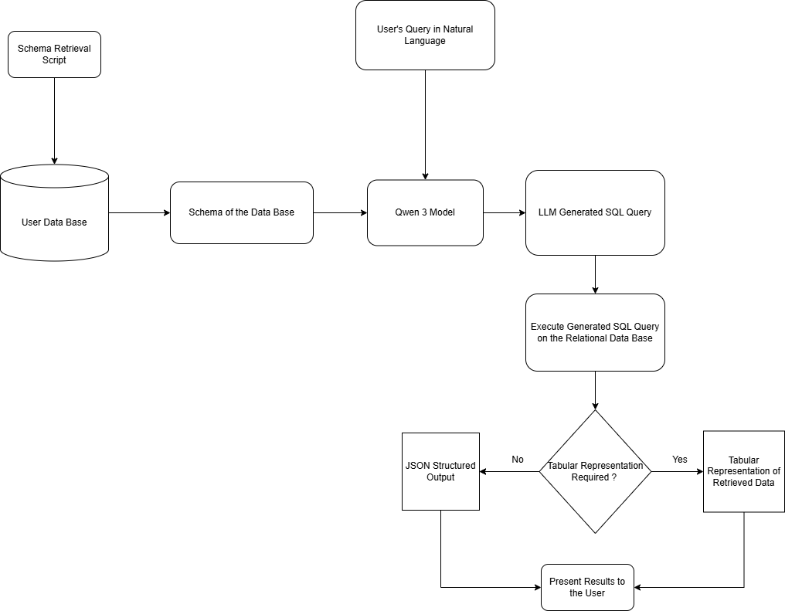
FLOW CHART
DEPARTMENT OF COMPUTER SCIENCE AND ENGINEERING
08

Slide 9
DEPARTMENT OF COMPUTER SCIENCE AND ENGINEERING
REVIEW 1 – Basic Functionality & Recreation of Base Paper (Completed)
Completed problem definition, literature survey, and documentation to understand existing research and identify gaps addressed by the project.
Designed the system architecture and implemented basic Natural Language to SQL conversion by recreating the functionality proposed in the base research paper.
Validated the feasibility of the system by generating and executing simple SQL queries from natural language inputs.
Created a simple HTML interface to understand the working of the SQL Buddy
09

Slide 10
DEPARTMENT OF COMPUTER SCIENCE AND ENGINEERING
REVIEW 2 – Adding More Functionalities
Extend the system to support complex SQL queries involving joins, nested queries, aggregations, and conditional operations.
Improve query validation, error handling, and schema understanding to enhance accuracy and reliability.
Optimize performance and scalability to handle larger schemas and more diverse user queries.
Use Streamlit to create a better good looking interface
We will try to incorporate voice based commands to get user’s query as input in natural language.
10

Slide 11
DEPARTMENT OF COMPUTER SCIENCE AND ENGINEERING
REVIEW 3 – Final Touch (Better UI & Functionalities)
Design and implement an improved user interface that enhances usability and interaction for non-technical users.
Add advanced features such as result visualization, clearer feedback messages, and better query explanations.
Perform extensive testing, optimization, and final refinements to ensure real-world applicability
We will try to support additional types of data bases to enhance its scalability .
11

Slide 12
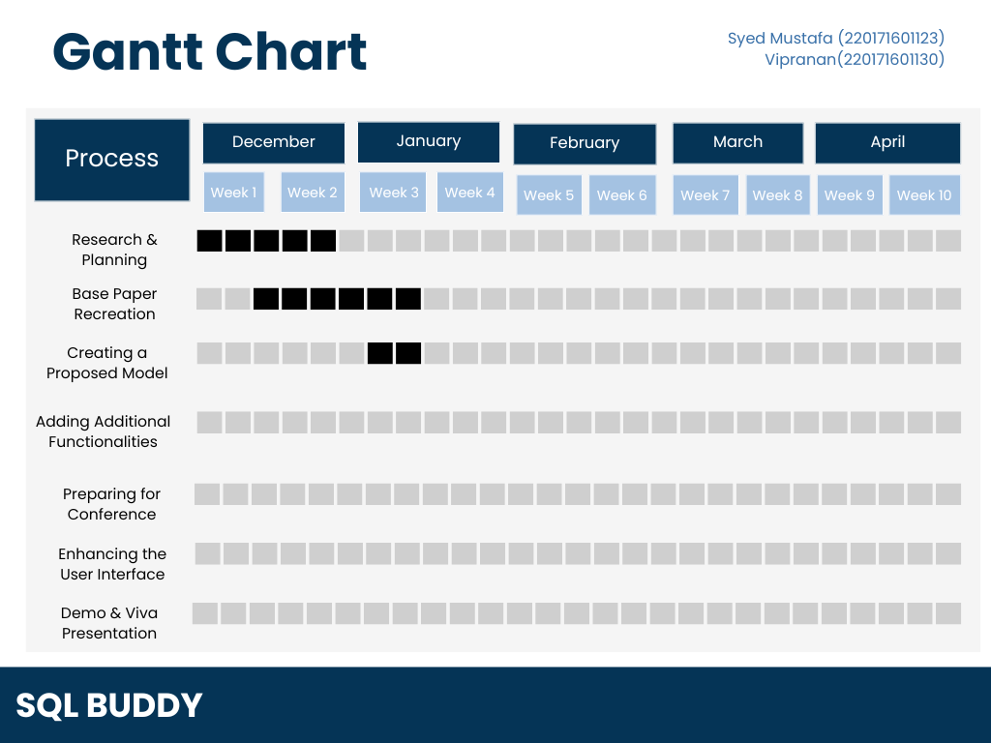
DEPARTMENT OF COMPUTER SCIENCE AND ENGINEERING
09

